Slide 1
Film Presentation
Cinematography
Saeed Mohiti Digvijaysingh Macwana

Slide 2
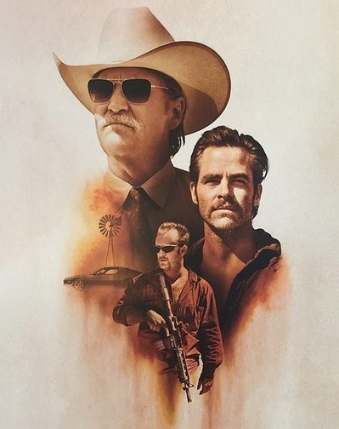
Hell or High Water
Release Date: 2016
Genre: Crime, Action, Suspense
Writer: Taylor Sheridan
Director: David Mackenzie
Cinematography: Giles Nuttgens
Stars: Chris Pine, Ben Foster, Jeff Bridges
Nominations:
BAFTA Award for Best Cinematography
Academy Award Golden Globe Award and more

Slide 3
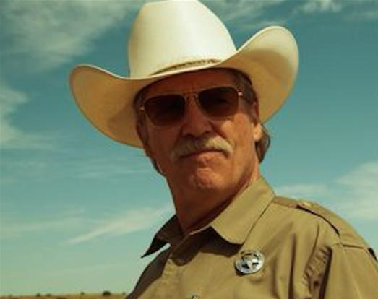
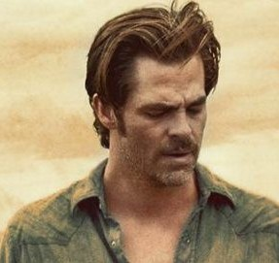
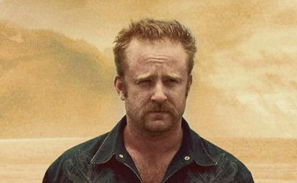
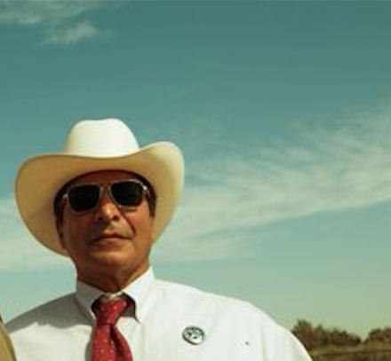
Storyline:
Toby is a divorced father who's trying to make a better life for his son. His brother Tanner is an ex-convict with a short temper and a loose trigger finger. Together, they plan a series of heists against the bank that's about to foreclose on their family ranch. Standing in their way is Marcus, a Texas Ranger who's only weeks away from retirement. As the siblings plot their final robbery, they must also prepare for a showdown with a crafty lawman who's not ready to ride off into the sunset.
Trailer

Slide 4
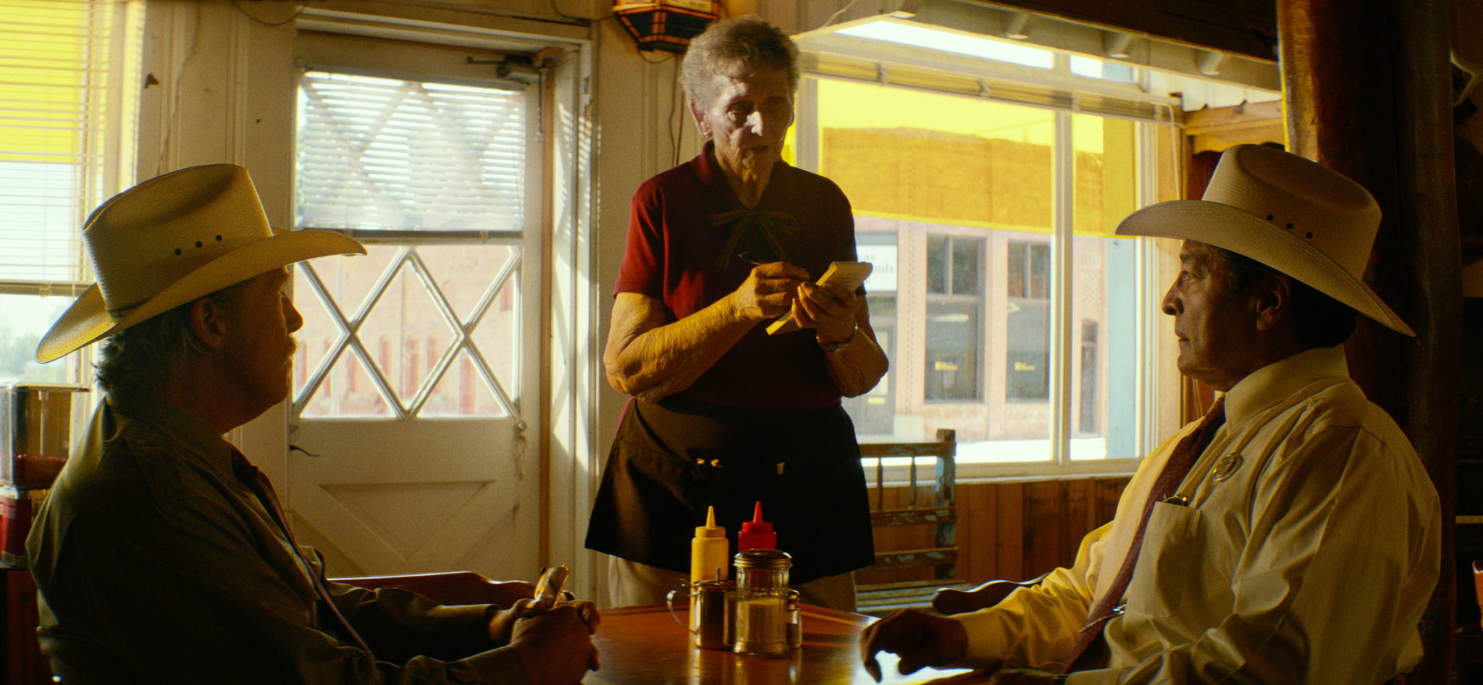
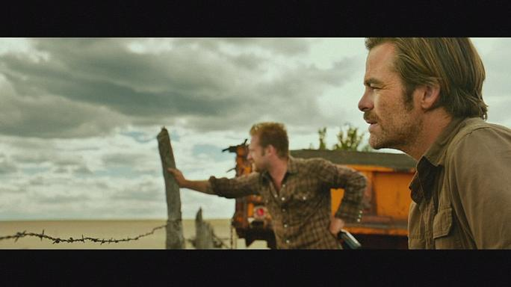
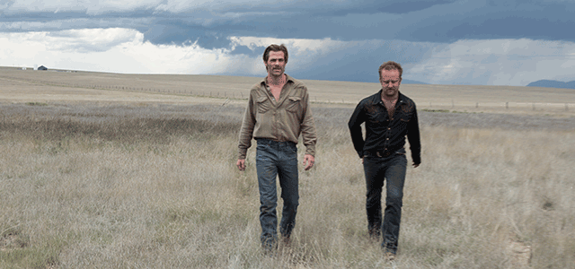
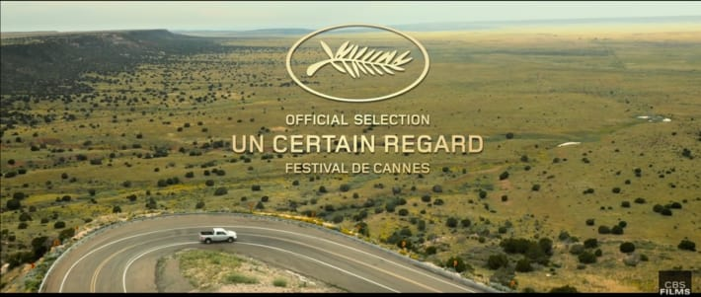
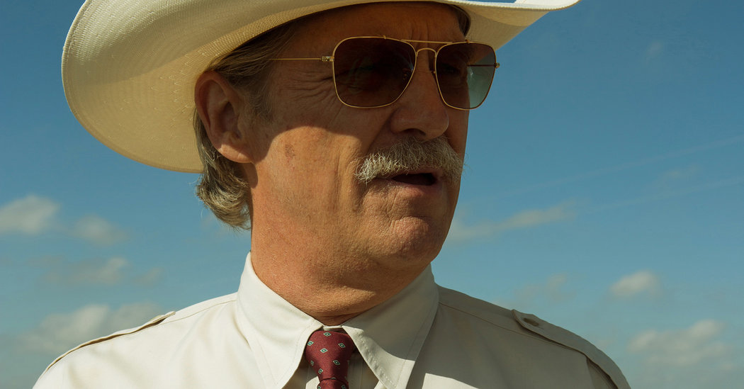
Cinematography
Cinematography is the act of capturing photographic images in space through the use of a number of controllable elements. These include the quality of the film stock, the manipulation of the camera lens, framing, scale and movement.
(www. Collegefilmandmediastudi.com)
Some techniques:
Long Shot
Close-up
Heli Shot
Deep Focus
Wide Angle
and more

Slide 5
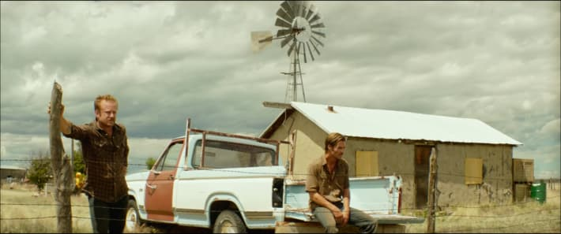
Hell or High Water is a film that spends its time split between two primary setups. Tight, often claustrophobic-feeling spaces, in places like banks, diners, and crumbling homes, or in epically large landscapes, like the flat open roads, or sprawling mountainsides of West Texas.

Slide 6
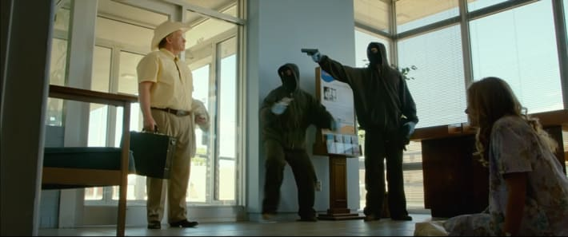
When exploring the smaller spaces, Nuttgens takes on numerous different angles to frame our lead characters. He always makes sure to fill the screen with people, allowing them to feel large and important. The interior scenes tended to be focused on intimate character moments or progression of the plot, and the film benefits from the cinematography providing us a glimpse at all of the characters involved. These tight shots are crafted to pull our vision towards what we need to see, and the dulled color scheme of the numerous indoor locations only stands to emphasize the glory of the grander shots.

Slide 7
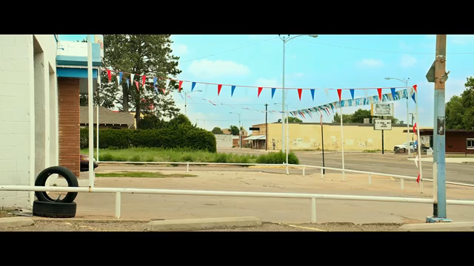
Camera movement was also crucial to establishing tone in “Hell or High Water.” The shots allowed the viewer to fully digest the dry, barren landscape, and choreographed movement involving 360 pans that equally engulf the environment and the slow pace of the characters within them. This shooting style is crucial to the story telling and is used in pivotal moments of the film, such as the first bank robbery.

Slide 8
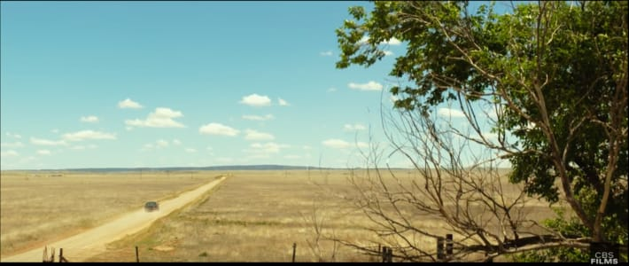
The film is filled with plenty of shots like the one above. The characters spend lengthy periods of time outdoors, and when Nuttgens transitions into these wide shots of the countryside they provide the perfect opportunity to examine the ideas being presented in the film, and to marvel at how small we are in this world. The characters are given much more space to breathe when we see them outside.

Slide 9
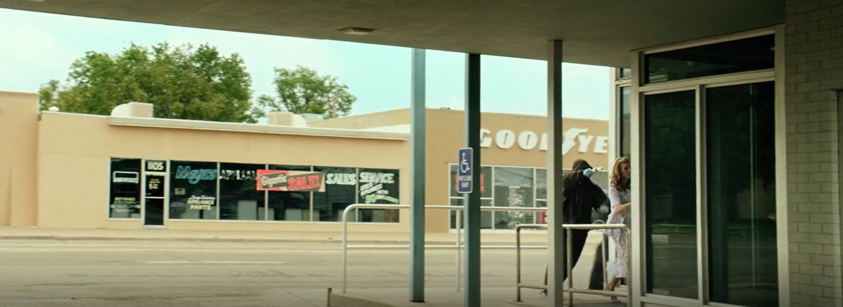
The film also features several lengthy shots, immediately sucks the viewer into the story and shows us the type of world we're getting into, a desolate, dirty, multi-dimensional place that leaves you wanting more. But while you want the shot to continue, the imagery is already showing you that seeing more might only prove to make things more morally complex than you want them to be,and Nuttgens has already found a way to give you multiple perspectives and a feast for your eyes.

Slide 10
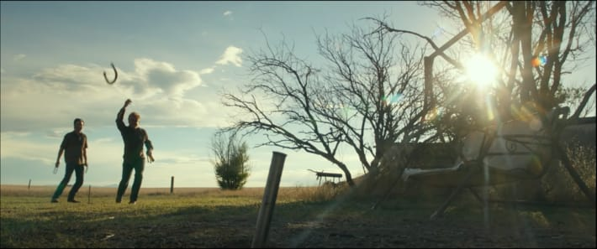
Conclusion
“We wanted to give you that massive contrast. The light blinds you and gives you a sense of heat,” said Nuttgens .
While the director, writer, and actors all put forth fabulous performances, it's the cinematography that really ties everything together. The shots in this presentation are only a small sampling of what the movie has to provide.

Slide 11
Thank You
Work Cited
www.moviepilot.com
Wikipedia
www.variety411.com

